Slide 1

WOXSEN UNIVERSITY
FROM TELANGANA, FOR INDIA’S FUTURE
The Vision
Infrastructure
Disciplines & Programs
Faculty
Global Partnerships
Accreditations & Rankings
Social Impact

Slide 2
Research Outcomes of B. Tech 3rd and 4th Year Students
Year | Research Articles | Conference Papers | Patents/Design Registration
B. Tech 3rd and 4th Year | 2 | 2 | 3

Slide 3
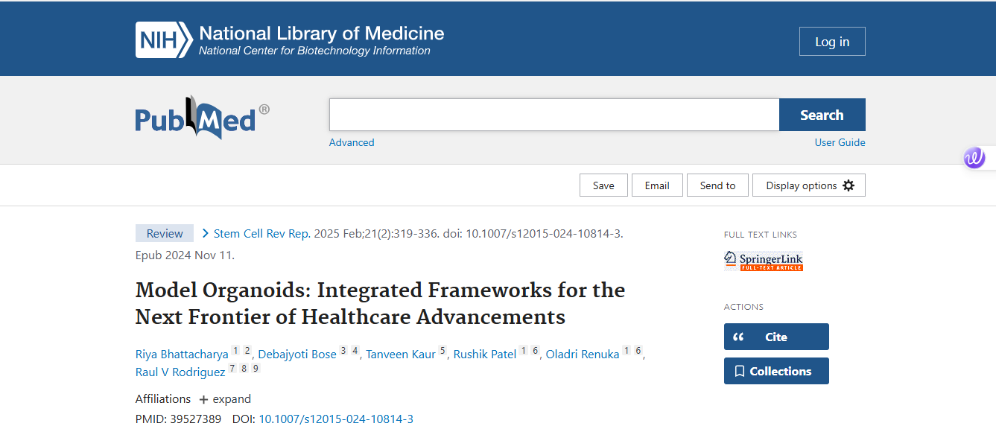
Research Article Published – B. Tech 4th year students

Slide 4
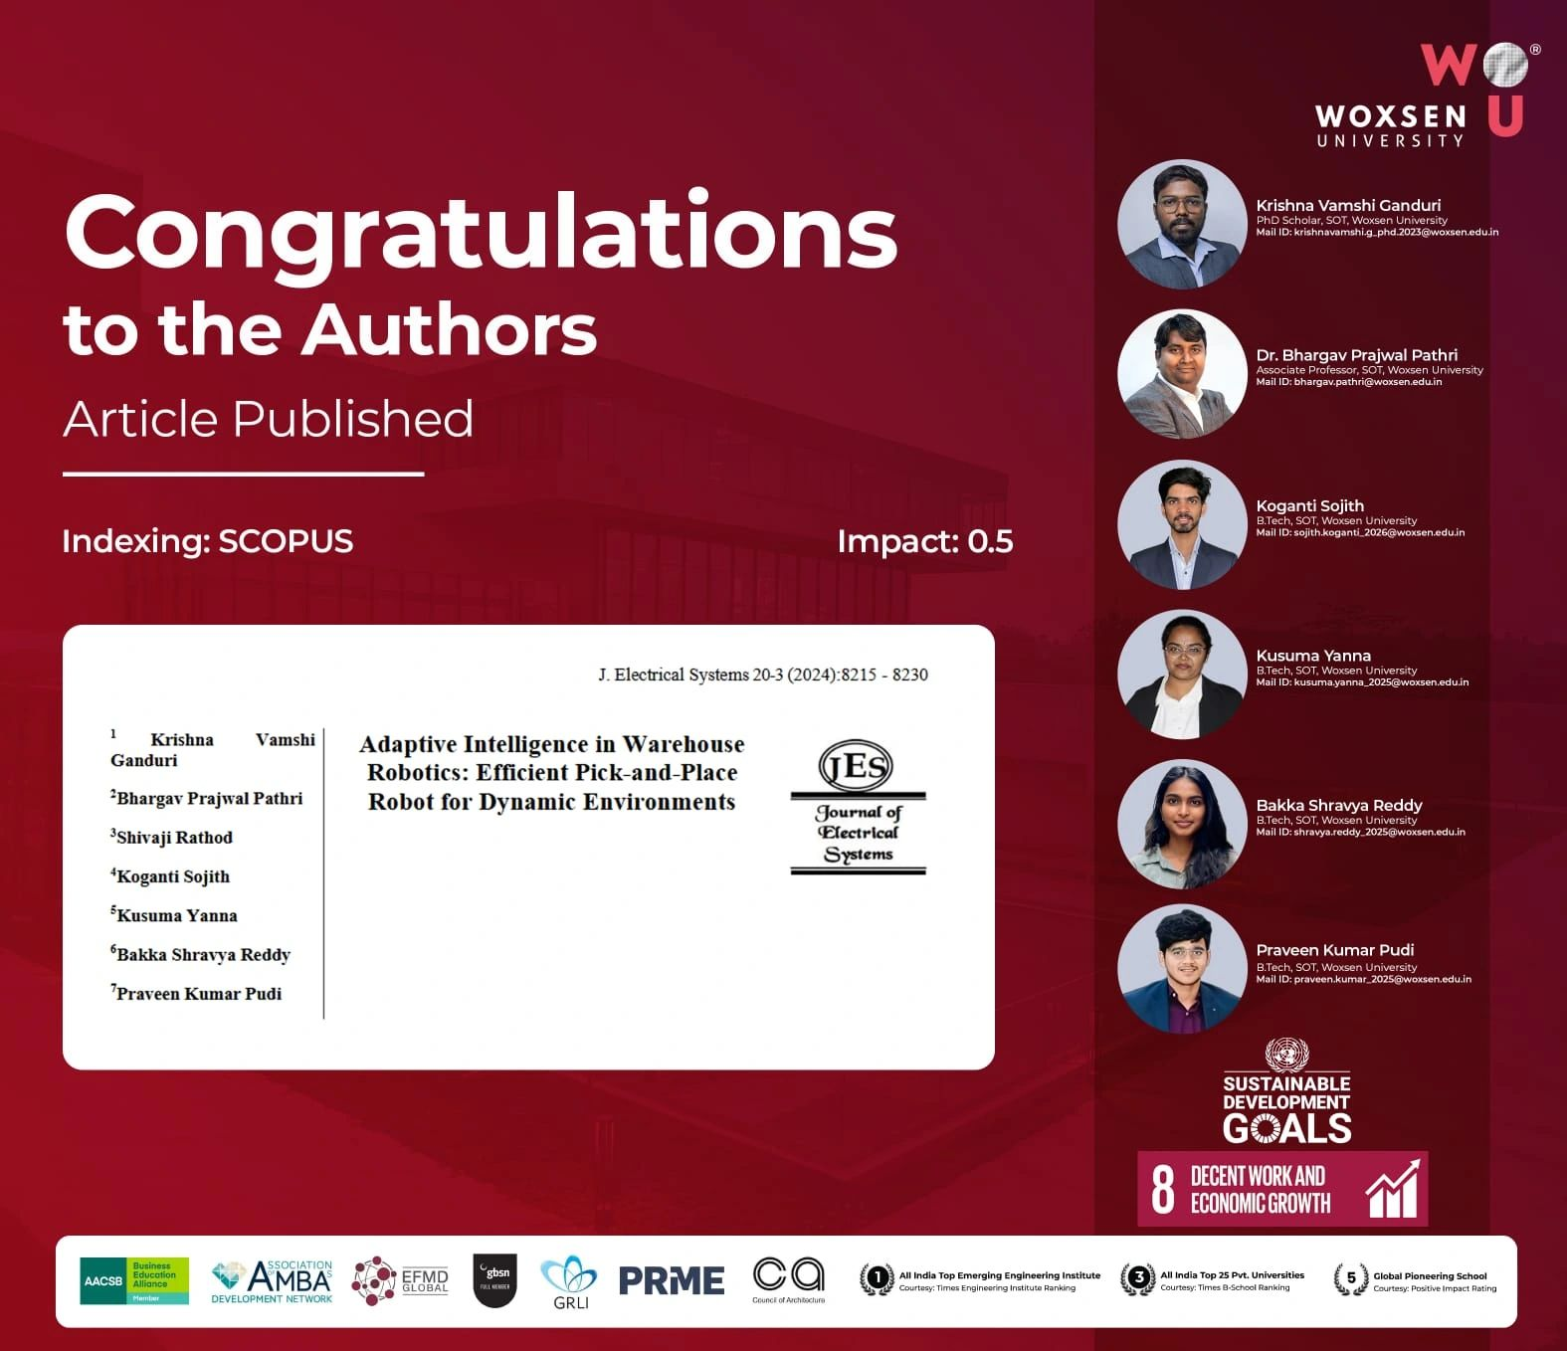
Research Article with B.Tech 4th year and 3rd year year student “Adaptive Intelligence in Warehouse Robotics: Efficient Pick-and-Place Robot for Dynamic Environments” has been officially published in the Journal of Electrical Systems (Indexed in SCOPUS | Impact Factor: 0.5)!

Slide 5
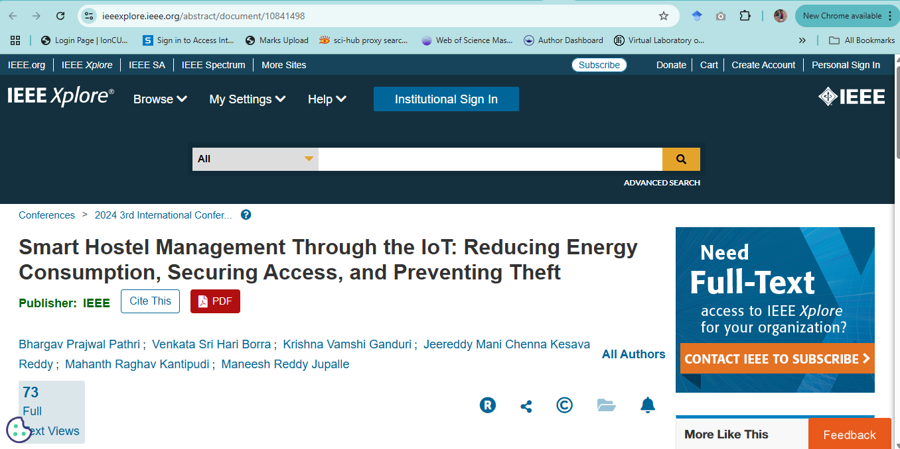
Conference Paper Published – B. Tech 4th year Students B. Prajwal Pathri, V. S. H. Borra, K. V. Ganduri, J. M. C. K. Reddy, M. R. Kantipudi and M. R. Jupalle, "Smart Hostel Management Through the IoT: Reducing Energy Consumption, Securing Access, and Preventing Theft," 2024 3rd International Conference on Automation, Computing and Renewable Systems (ICACRS), Pudukkottai, India, 2024, pp. 483-489, doi: 10.1109/ICACRS62842.2024.10841498.

Slide 6
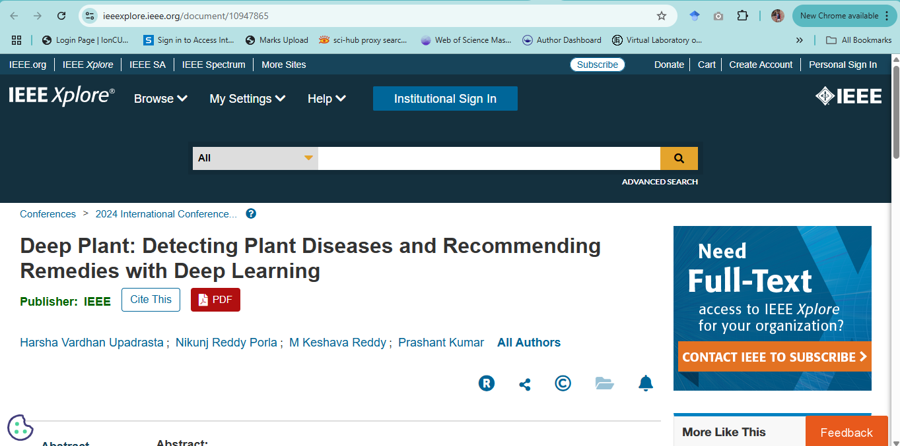
Conference Paper Published – B. Tech 4th year Students - H. V. Upadrasta, N. R. Porla, M. K. Reddy and P. Kumar, "Deep Plant: Detecting Plant Diseases and Recommending Remedies with Deep Learning," 2024 International Conference on Artificial Intelligence and Emerging Technology (Global AI Summit), Greater Noida, India, 2024, pp. 1071-1076

Slide 7
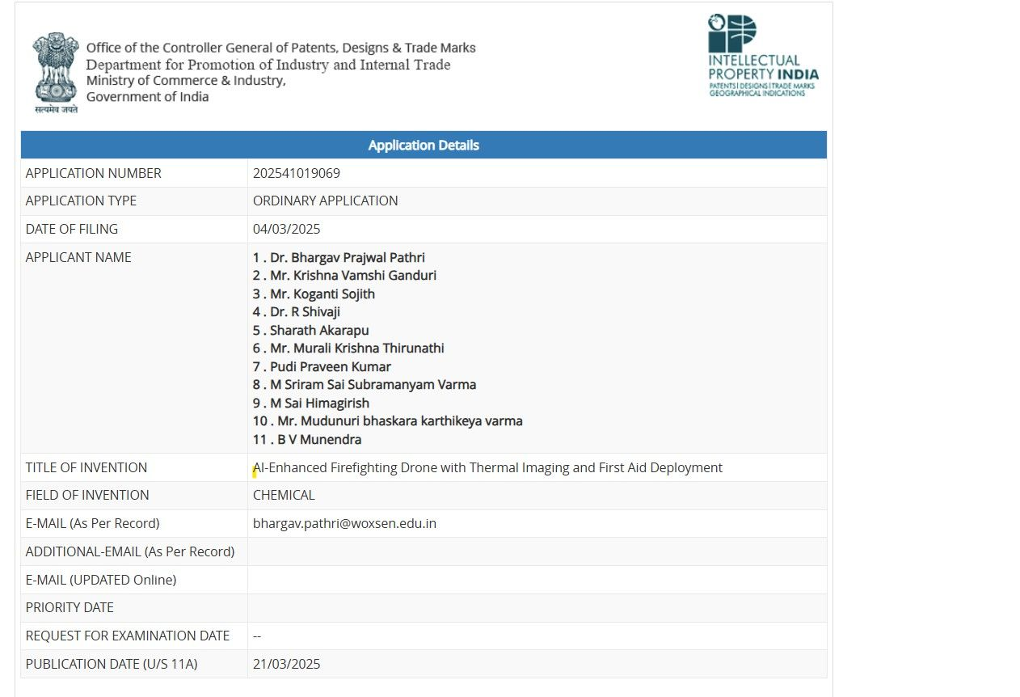
Patent Published – 3rd and 4th Year B. Tech students. Title: Enhanced Fire Fighting Drone with Thermal Imaging and First Aid Deployment – Application No. 202541019069

Slide 8
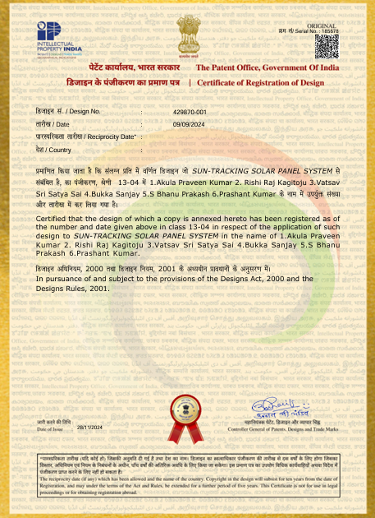
B. Tech 3rd Year Students Design Registration: Sun-tracking solar panel system

Slide 9
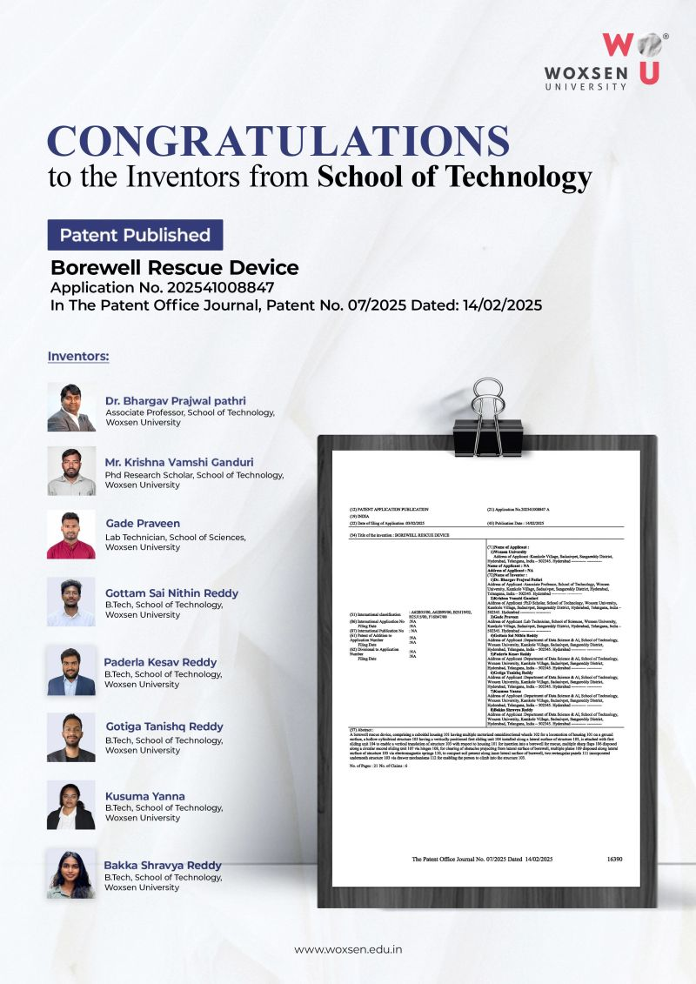
Patent Published – B.Tech 4th Year Students
Title: Borewell Rescue Device – Application No. 202541008847

Slide 10


THANK YOU

